Slide 1
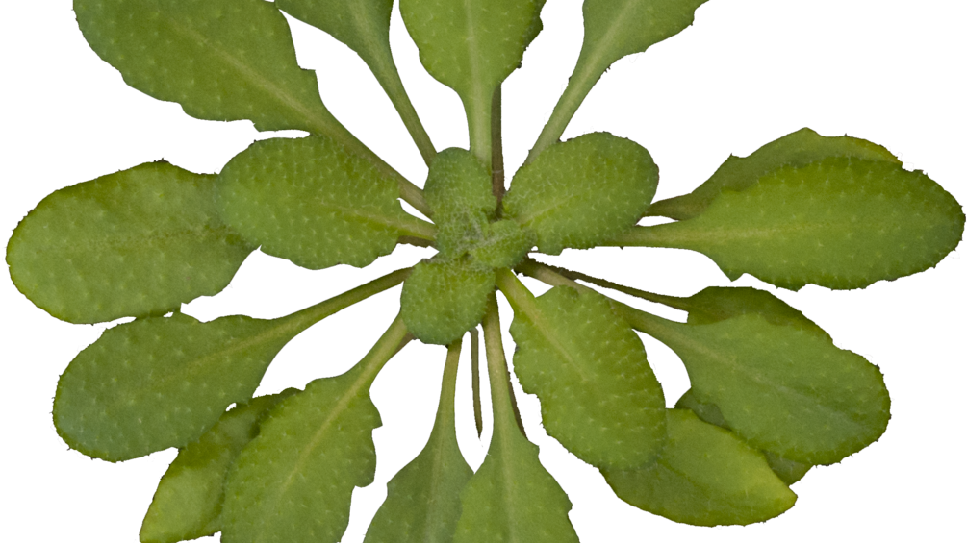
Functional Analysis of LEA-3 Proteins
Ralph Arvin De Castro
BIOM*4521 |Supervisor: Steffen Graether
Notes:
Hi, everyone, my name is Ralph and my research topic is all about investigating and analyzing the function of this protein called LEA-3 protein.

Slide 2
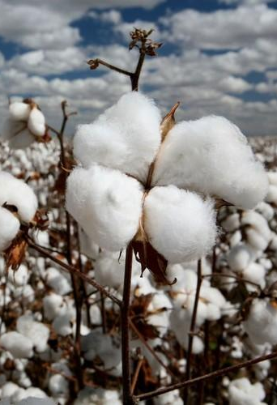
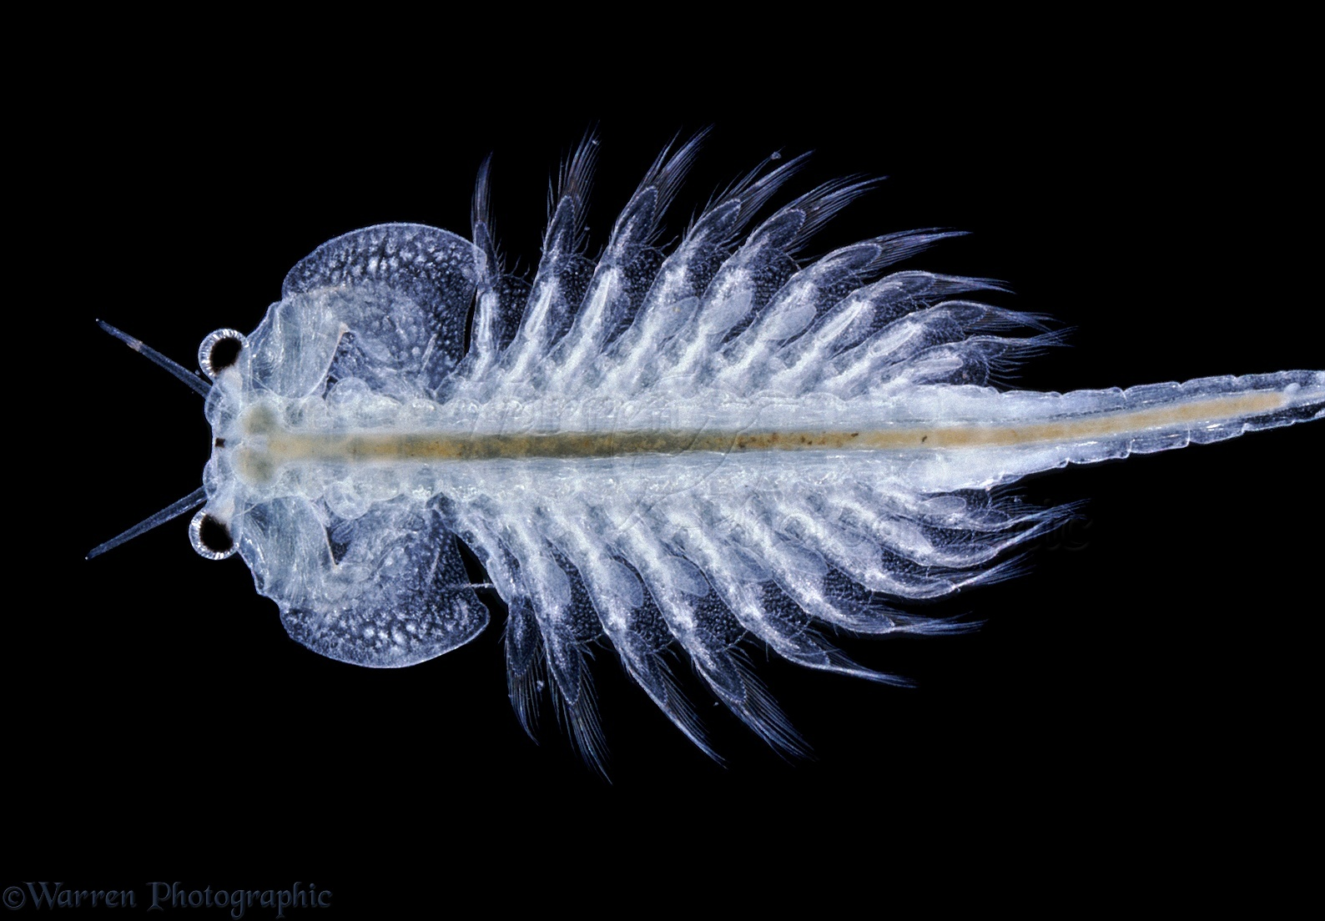
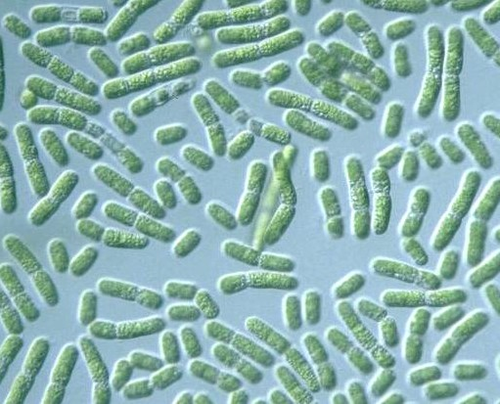
Introduction
What are LEA Proteins?
Late Embryogenesis Abundant proteins
Large group of proteins that accumulate in the late embryogenesis of seeds
First found in plants such as cotton seeds
Not plant specific: LEA-like proteins also found in non-plant species
Brine Shrimp
Cotton
Cyanobacteria
Notes:
To start, I will give you an overview about LEA proteins and a recap from last semester,
So LEA proteins or late embryogenesis abundant proteins are a large group of proteins that accumulate or become abundant in the late embryogenesis stage of seeds
They were first discovered in cottons but also later found that they do not only occur in plants because they were also detected in other species such as brine shrimp and cyanobacteria

Slide 3
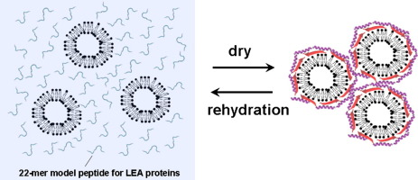
LEA Protein Function
Function in desiccation tolerance
LEA Proteins have been associated with cellular resistance to dehydration
Protect other proteins from aggregation during abiotic stresses (freezing, drying and saline conditions)
Mechanism about this structure-function relationship is still unclear
Furuki et.al (2014)
Notes:
LEA proteins have been correlated to have a function desiccation tolerance which means that lea proteins help with tolerance of cells to dehydration.
They do this by protecting other proteins from aggregating with each other as you can see in this picture
However, the mechanism about this is still unclear and this is what our topic of interest is.

Slide 4
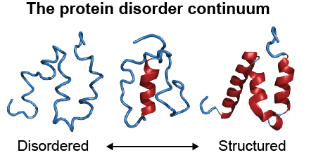
LEA Protein Structure
Hydrophilic – low hydrophobicity
Disordered - belongs to the structural group called intrinsically disordered proteins (IDP).
do not have a defined structure
can gain structure when a ligand is bound.
Weis (2011)
Notes:
In terms of structure, LEA3- proteins are hydrophilc and h
Morever, they are also disordered as they belong to the structural group called intrinsically disordered protein or IDPs in short.
These proteins do not have a defined structure as you can see from the image.
However, they can gain structure when a ligand binds which suggests that these proteins can have a functional role
However, they can can gain structure wgen a ligand is bound

Slide 5
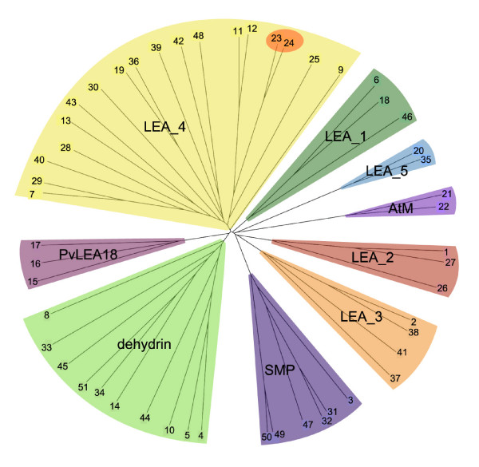
LEA Protein Subgroups
LEA proteins have been grouped into various families on by sequence similarity
In Arabidopsis thaliana, there are 9 sub-groups of LEA protein
Hundertmark et.al (2008)

Slide 6
LEA Protein Subgroups
LEA proteins have been grouped into various families on by sequence similarity
In Arabidopsis thaliana, there are 9 sub-groups of LEA protein
Focus subgroup:
LEA-3 proteins
Hundertmark et.al (2008)

Slide 7
LEA Protein Subgroups
Why LEA-3 Proteins?
Under-researched compared to dehydrins (another subgroup)
No novel function for abiotic stress defined
LEA proteins have been grouped into various families on by sequence similarity
In Arabidopsis thaliana, there are 9 sub-groups of LEA protein
Focus subgroup:
LEA-3 proteins
Hundertmark et.al (2008)
Notes:
LEA proteins have been group into various families and they are grouped according to their sequence similarity
In Arabidopsis thaliana, a plant, there are 9 subgroups of LEA-protein
The subgroup that we focused on are LEA-3 proteins
And we are interested in this subgroup
Under-researched compared to dehydrins (another subgroup)
No novel function for abiotic stress defined

Slide 8
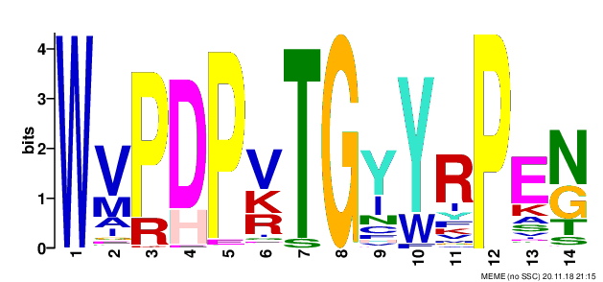
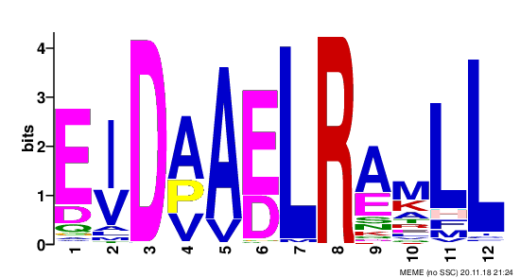
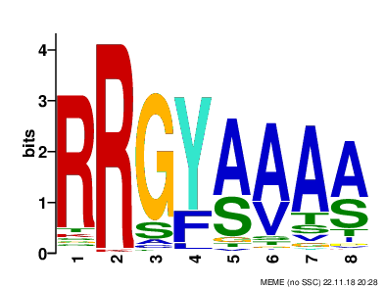
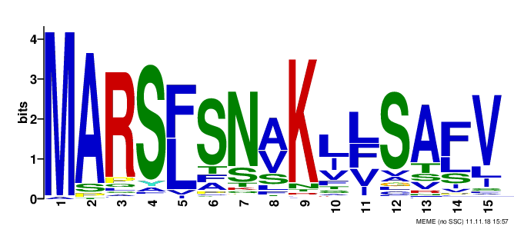
LEA3 Protein Motifs
Structural analysis of LEA-3 protein motifs using bioinformatics tools
Protein motifs – conserved regions of the protein family
Motif | E-Value | Sites | Width
 | 1.3e-8373 | 871 | 14
 | 7.5e-3738 | 574 | 12
 | 1.7e-1324 | 544 | 8
 | 3.9e-1818 | 290 | 15
Notes:
Last semester, we performed a structural analysis of LEA-3 proteins using bioinformatics tools
And to review, protein sequence motifs are conserved regions of the protein family and these sequence can be used to predict the function of the protein
We proposed four sequence motifs,
W-motif is the most conserved motif and the most defining feature of LEA-3 proteins, which can imply an important function.

Slide 9

Position of motifs
N-terminus
C-terminus
Notes:
We also looked at the position of the motifs. And one hypothesis that we have made is that MARS-motif which is at the N-terminus could act as a signal peptide for this protein

Slide 10
LEA Proteins and Ion Binding
Cell in abiotic stress (freezing, drying and saline conditions)
increase in concentration of intracellular components, including ions.
Other subgroups of LEA proteins (dehydrins, LEA4) are able to bind metal ions (Liu et. al).
Notes:
As I have mentioned from the previous slides, LEA proteins are expressed in abiotic stress conditions
And during abiotic stress, there is an increase of ion concentration which leads to cell damage
One of the mechanism of LEA protein function proposed by other studies is that it can bind to metal ions.

Slide 11
OBJECTIVES
Perform a functional analysis of LEA3 proteins by investigating their metal-binding properties
HYPOTHESIS
LEA3 proteins have a protective role in reducing oxidative damage by binding to specific metal ions that might cause ROS formation
Notes:
Our main objective for this research project is to Perform a functional analysis of LEA3 proteins by investigating their metal-binding properties
LEA3 proteins have a protective role in reducing oxidative damage by binding to specific metal ions that might cause ROS formation

Slide 12
Methodology
Expression of LEA-3 Protein
Immobilized metal ion affinity chromatography (IMAC)
Sumo-LEA Protein Purification
SDS-Page Analysis
Notes:
Here is the overview of the methodology which can be divided into four parts

Slide 13
Methodology
Expression of LEA-3 Protein
Immobilized metal ion affinity chromatography (IMAC)
Sumo-LEA Protein Purification
SDS-Page Analysis
Notes:
Firstly, we want to express our LEA3-4 protein for analysis.

Slide 14
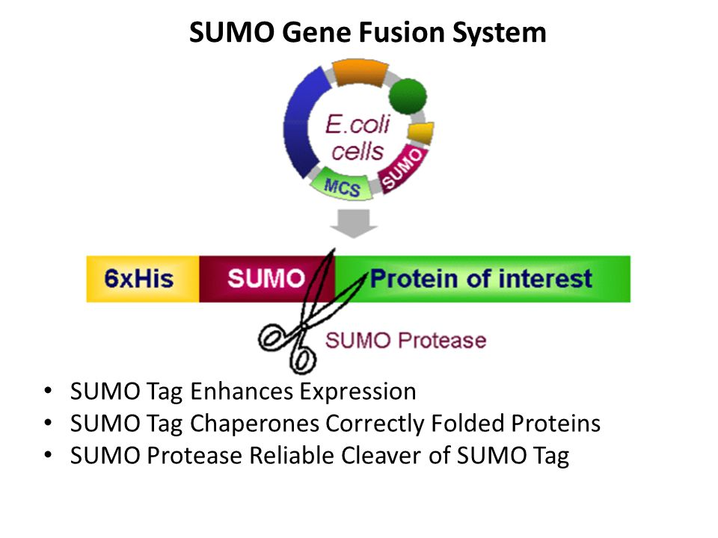
Materials
Plasmid: pET-SUMO (solubility tag) + LEA3-4 gene
Full Length (whole sequence)
MSQSLFNLKSLSRSINNTIRMRRYIVITKASQRAYTIGSSQEKPSWASDPDTGYFRPETAAKELDPYIAKTSQVQGKMMRGEELWWMPDPQTGYYRPDNFARELDAVELRSLHFNKNQKTYVVS
Truncated (N- or C-terminal eliminated)
TIGSSQEKPSWASDPDTGYFRPETAAKELDPYIAKTSQVQGKMMRGEELWWMPDPQTGYYRPDNFARELDAVELRSLHFNKNQKTYVVS
Notes:
Our gene is cloned into a plasmid. One is full length and one gene is truncated

Slide 15
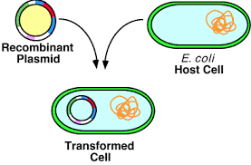
Expression of LEA-3 Protein
pET-SUMO (solubility tag) + LEA3-4 plasmid was transformed into E.coli BL21 (DE3).
Cultures were grown in LB (Luria–Bertani) medium with kanamycin antibiotic at 37C.

Slide 16
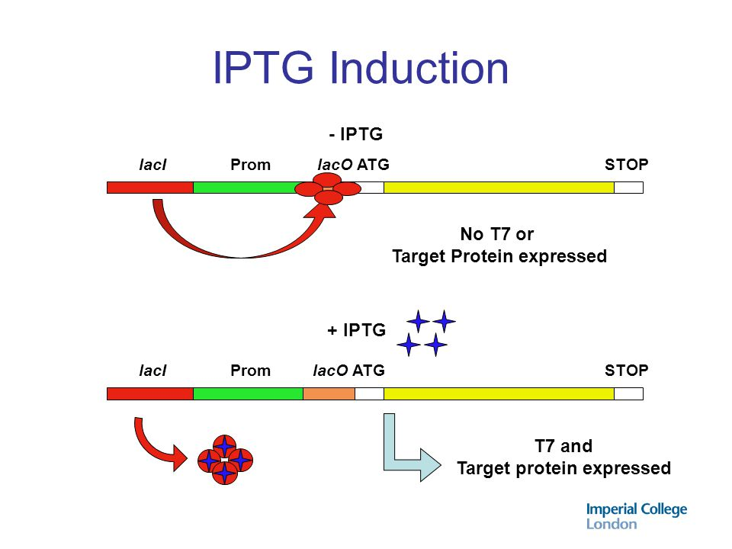
Expression of LEA-3 Protein
3. Treated with isopropyl-B-D-thiogalactopyranoside (IPTG) to induce expression of protein

Slide 17
Methodology
Expression of LEA-3 Protein
Immobilized metal ion affinity chromatography (IMAC)
Sumo-LEA Protein Purification
SDS-Page Analysis
Notes:
Here is the overview of the methodology of methodology.

Slide 18
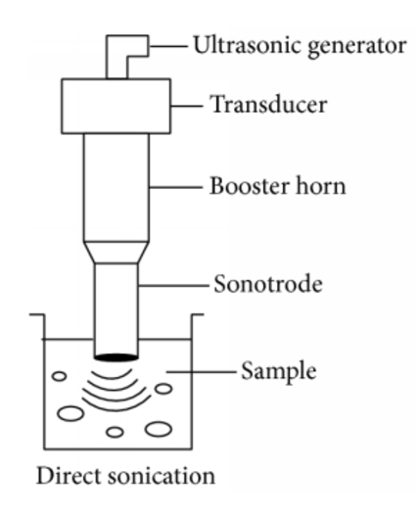
Sumo-LEA Protein Purification
1 .Bacterial cell was lysed using sonication to solubilize and isolate proteins from cell.

Slide 19
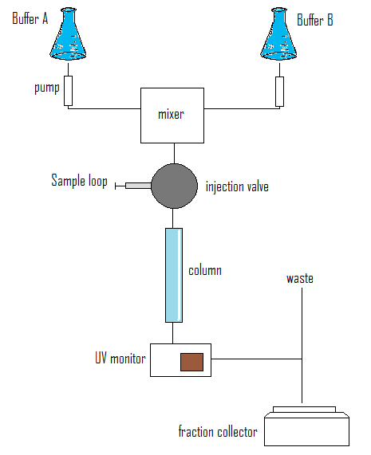
Sumo-LEA Protein Purification
2. Fast protein liquid chromatography (FPLC) was used to purify SUMO-LEA3-4 proteins.
Column: HisTrap

Slide 20
Sumo-LEA Protein Purification
3.Digestion – cleaves SUMO using protease (ULP1)
4.FPLC and HPLC was performed again to fully isolate LEA3-4 from SUMO and other unwanted contents
Notes:
(Sumo has his-tag (His trap (will bind)
Histrap has nickel (sumo will bind because of his tag (6 histidines
Elute with imidazole gradient

Slide 21
Methodology
Expression of LEA-3 Protein
Immobilized metal ion affinity chromatography (IMAC)
Sumo-LEA Protein Purification
SDS-Page Analysis
Notes:
Here is the overview of the methodology of methodology.

Slide 22
Immobilized metal ion affinity chromatography (IMAC)
8 metal ions
Ca2+, Co2+, Cu2+, Fe2+, Fe3+, Mg2+, Ni2+, Zn2+
Bovine Serum Albumin (BSA) – used as positive control
Metal Ion | +
Fe2+ | +
Fe3+ | +
Ni2+ | +
Cu2+ | +
Zn2+ | +
Ca2+ | -
Mg2+ | -
Co2+ | -
Notes:
Most physiological relevant
Most common in mitochondria and chloroplast
Most likely to cause ROS formation

Slide 23
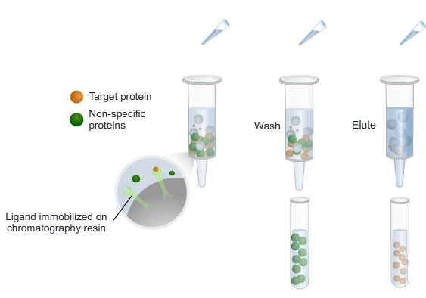
Immobilized metal ion affinity chromatography (IMAC)
Each ion will be washed with EQ buffer and will be eluted with EDTA buffer.
Wash buffer: protein does not bind in that specific ion
Elution buffer: protein binds to that specific ion

Slide 24
Methodology
Expression of LEA-3 Protein
Immobilized metal ion affinity chromatography (IMAC)
Sumo-LEA Protein Purification
SDS-Page Analysis
Notes:
And lastly we are using sds-page gels for analysis

Slide 25
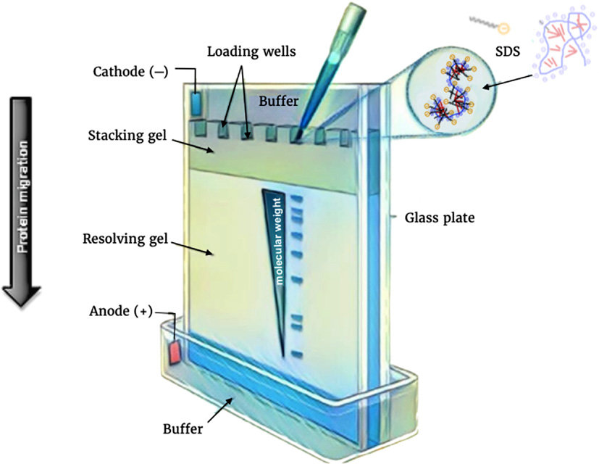
SDS-Page Gel analysis
Our samples were loaded into different wells
Helps identify and isolate protein molecules by molecular weight
Notes:
S

Slide 26
Results
Notes:
And after going through our methodology, we finally have our results

Slide 27
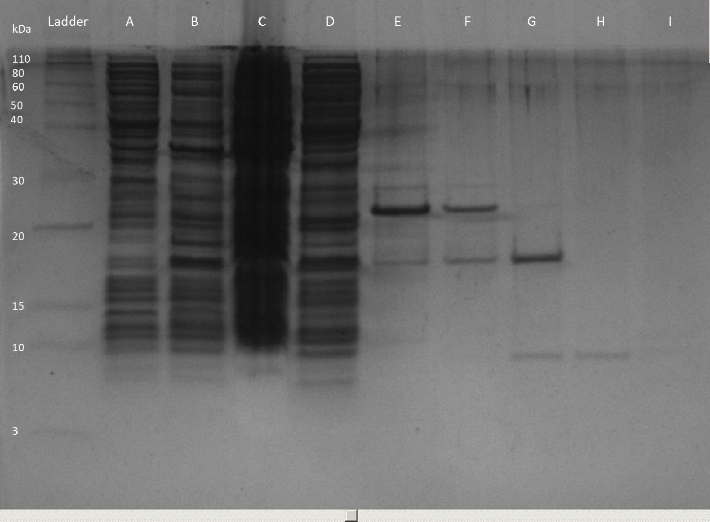
Solubility of LEA3-4 Protein (Truncated)
A. Pre-induction
B. Post-induction
C. Insoluble fraction after bacterial pellet lysis
D. Soluble fraction after bacterial lysis
E. Eluted FPLC #1 fraction
F. Pre-digestion with ULP1
G. Post-digestion with ULP1
H. Flow through from FPLC #2
I. Eluted HPLC fraction
LEA3-4
SDS-PAGE gel showing the purification of LEA3-4 protein (Truncated)
Notes:
What you see in this slide is a SDS-page gel showing the purification of truncated LEA3-4 protein.
Each lane has a different sample and corresponds to a different step of purification.
Our lane A and B shows the contents of bacterial culture before and after induction
And our lane C and D shows fractions after bacterial lysis and FPLC
Lane E shows the elution of our fractions
Our lane f and g shows pre and post digestion of sumo and lea3-4 with upl1
And after running through FPLC .
Our lane I shows that we successfully purified our LEA3-4 protein truncated

Slide 28
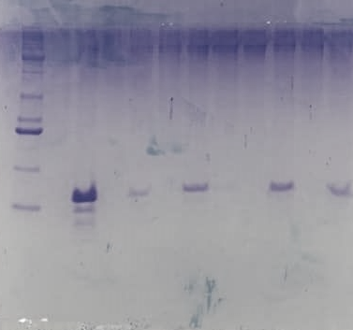
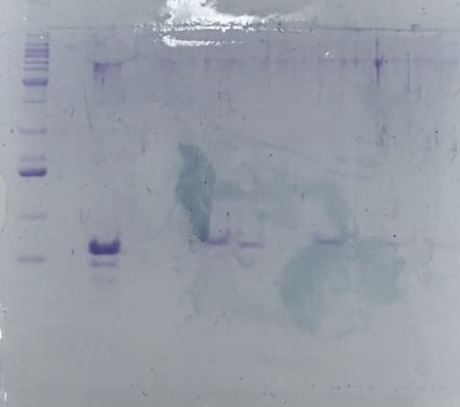
Immobilized metal ion affinity chromatography (IMAC)
Ca²⁺
Co²⁺
Cu²⁺
Fe²⁺
Fe³⁺
Mg²⁺
Ni²⁺
Zn²⁺
Ladder LEA3-4 1A 1B 2A 2B 3A 3B 4A 4B
Ladder LEA3-4 5A 5B 6A 6B 7A 7B 8A 8B
Cu²⁺
Fe²⁺
Fe³⁺
EQ Buffer
EDTA Buffer
SDS-PAGE gel showing results of Immobilized metal ion affinity chromatography (IMAC) LEA3-4 protein (Truncated)
Notes:
Because our truncated LEA3-4 protein is soluble, we are able to do the ion affinity chromatography
These two SDS-gels shows us if LEA3-4 protein binds to these 8 specific ions.
Once again, we have our ladder for molecular weight reference, and our protein
And each ion
Our results show that LEA3-4 binds to iron and copper ions

Slide 29
Solubility of LEA3-4 Protein (Full-Length)
Insoluble
Different incubation periods (overnight, 3 hours)
Different temperatures at incubation (16C, 37C)
Urea
Unable to purify protein
Unable to perform IMAC chromatography
Notes:
After expressing the LEA protein and trying to p
Soluble with Urea????
powerful protein denaturant as it disrupts the noncovalent bonds in the proteins. This property can be exploited to increase the solubility of some proteins
Couldn’t remove urea and keep it soluble
urify it

Slide 30
Summary of Results
LEA3-4
Protein
Metal ion | BSA (+) | Truncated | Full Length
Fe2+ | + | + | Insoluble
Ni2+ | + | - | Insoluble
Cu2+ | + | + | Insoluble
Zn2+ | + | - | Insoluble
Ca2+ | - | - | Insoluble
Mg2+ | - | - | Insoluble
Co2+ | - | - | Insoluble
Fe3+ | + | + | Insoluble
Ladder
Truncated LEA3-4 binds Fe ions and Copper ions
Full-length LEA3-4 was insoluble
Notes:
And to summarize, truncated LEA3-4 protein binds to iron and copper ions,
On the other hand, full-length was insoluble in vitro

Slide 31
Discussion
Notes:
And after going through our methodology, we finally have our results

Slide 32
LEA3-4 and Antioxidant role
Our results suggest that LEA3 proteins has antioxidant properties
Fe and Cu ions could produce hydroxyl radicals (•OH) that cause oxidative damage
LEA3-4 binds to these metal ions and reduces ROS formation and oxidative stress
Histidine residues are involved in the metal binding of proteins (Dehydrins and LEA4) (Hara et al.).
Notes:
Truncated LEA3-4 binding to iron and copper ions suggests that LEA3-4 proteins has antioxidant properties which could reduce ROS formation and oxidative damage which supports our hypothesis.
Another thing to note is that LEA3 proteins has a histidine residue and it has shown that histidine content are somehow involved in the metal binding proteins such as in dehydrins and LEA4

Slide 33
Insolubility of LEA3-4 (Full Length)
Full-length LEA-3 is insoluble
MARS-motif
Located at the N-terminus
Could be a mitochondrial or chloroplast targeting peptide
Allows to be imported in these subcompartments
Notes:
Another important aspect to discuss is how truncated lea 3 was soluble full-length lea 3 was insoluble and we speculate that this is due to the N-terminus motif or MARS-motif is a signal peptide, Our protein might be localized in mitochondria or chloroplast, making it hard for us to solubilize

Slide 34
Further Analysis
Isothermal titration calorimetry (ITC)
Quantitatively estimate binding between LEA3 protein and metals
Notes:
Micelles
Liposomes –
Other things to look at – membrane protection using liposomes fake membrane

Slide 35
Conclusion
LEA3 protein binds to iron and copper ions, suggesting antioxidant properties
Motif in N-terminus could be a signal peptide to mitochondria or chloroplast
Could be further analyzed with ITC

Slide 36
References
Malik, A. A., Veltri, M., Boddington, K. F., Singh, K. K., & Graether, S. P. (2017). Genome Analysis of Conserved Dehydrin Motifs in Vascular Plants. Frontiers in plant science, 8, 709. doi:10.3389/fpls.2017.00709
Furuki T, Sakurai M. Group 3 LEA protein model peptides protect liposomes during desiccation. Biochimica et biophysica acta. 2014;1838(11):2757–66. Epub 2014/07/19. doi: 10.1016/j.bbamem.2014.07.009
Hundertmark, M., & Hincha, D. K. (2008). LEA (late embryogenesis abundant) proteins and their encoding genes in Arabidopsis thaliana. BMC genomics, 9, 118. doi:10.1186/1471-2164-9-118
Goyal K, Walton LJ, Tunnacliffe A. LEA proteins prevent protein aggregation due to water stress. Biochem J. 2005;388:151–157. doi: 10.1042/BJ20041931.

Slide 37
Questions?

